Slide 1

Data Driven Applications
Client-Server Architecture
Web hosting
Web Servers
Web Apps - L01

Slide 2
Learning Outcomes
You will be able
Describe the client server computing architecture and its main features
Using a client server diagram:
to describe how web pages are accessed across the internet
Be able to author a simple html web page

Slide 3
Client Server Architecture
Client-server is a computing architecture which separates a client from a server, and is almost always implemented over a computer network.
Each client or server connected to a network can also be referred to as a node.
The most basic type of client-server architecture employs only two types of nodes: clients and servers.
This type of architecture is sometimes referred to as two-tier.
It allows devices to share files and resources.

Slide 4
Client Server Architecture
These days, clients are most often web browsers, although that has not always been the case.
Servers typically include
web servers
database servers
mail servers.

Slide 5
Client-Server
Some hosts on the internet are clients, others are servers.
Clients use servers to do stuff for them!
Examples:
Web browser clients must use a Web SERVER
Email clients must use a Mail Server

Slide 6
DBS and Client-Server
Client-Server is a typical architecture employed when making databases accessible to multiple users.
The database resides on a DBMS which acts as a SERVER
The client is usually an application running on another computer on a network

Slide 7
DBS – Logical Architecture
DBS
Application Programs
DBMS
Database
DB
Application
Data
DB
Metadata

Slide 8
DBS – Client-Server - Physical Architecture
Client
Application
Accounts Department
Local Area Network
Client
Application
Sales Department
DATABASE
Server (DBMS)

Slide 9
Web Applications
Many commercial enterprises make their databases accessible to internal and external users via the internet.
This is a form of client-server architecture also.
Web applications permit ‘dynamic’ creation of web page content – ie the content depends on user choices
To understand how web applications work it is first necessary to understand how a standard/static web page is accessed by a client.

Slide 10
WWW and Client-Server
The following slides illustrate the client-server process used to download a typical web page
Components
Web http Server (IIS,Apache, ..)
Web Browser (Explorer, Mozilla Firefox ..)
Domain Name System Server (DNS)

Slide 11

WWW and client server process
Step 1 – Start Client browser
Client
Browser
Application
Internet
http
Web Server
DNS
Domain Name Server
69.16.175.42
www.irishrugby.ie

Slide 12
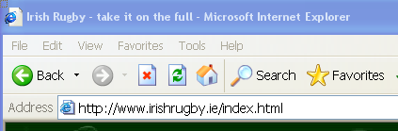
WWW and client server process
Step 2 – enter desired URL
In Browser
Client
Browser
Application
Internet
Web Server
DNS
Domain Name Server
69.16.175.42
www.irishrugby.ie

Slide 13
WWW and client server process
Step 3 – Browser requests IP address of web server from DNS
Client
Browser
Application
Tip!
Use this website to look up host names/IP addresses:
http://www.bankes.com/nslookup.htm
www.irishrugby.ie ?
Web Server
DNS
Domain Name Server
69.16.175.42
www.irishrugby.ie

Slide 14
WWW and client server process
Step 4 –DNS responds with the IP address of the web server
69.16.175.42
Web Server
DNS
Domain Name Server
194.154.200.217
www.irishrugby.ie
69.16.175.42
www.irishrugby.ie

Slide 15
WWW and client server process
Step 5 –Browser uses the IP address to request resource (index.html) from web server
send me Index.html ?
LIT
DNS
Domain Name Server
194.154.200.217
www.irishrugby.ie
69.16.175.42
www.irishrugby.ie

Slide 16
WWW and client server process
Step 6 –web server sends resource to browser client
here is Index.html
Web Server
DNS
Domain Name Server
194.154.200.217
www.irishrugby.ie
69.16.175.42
www.irishrugby.ie

Slide 17
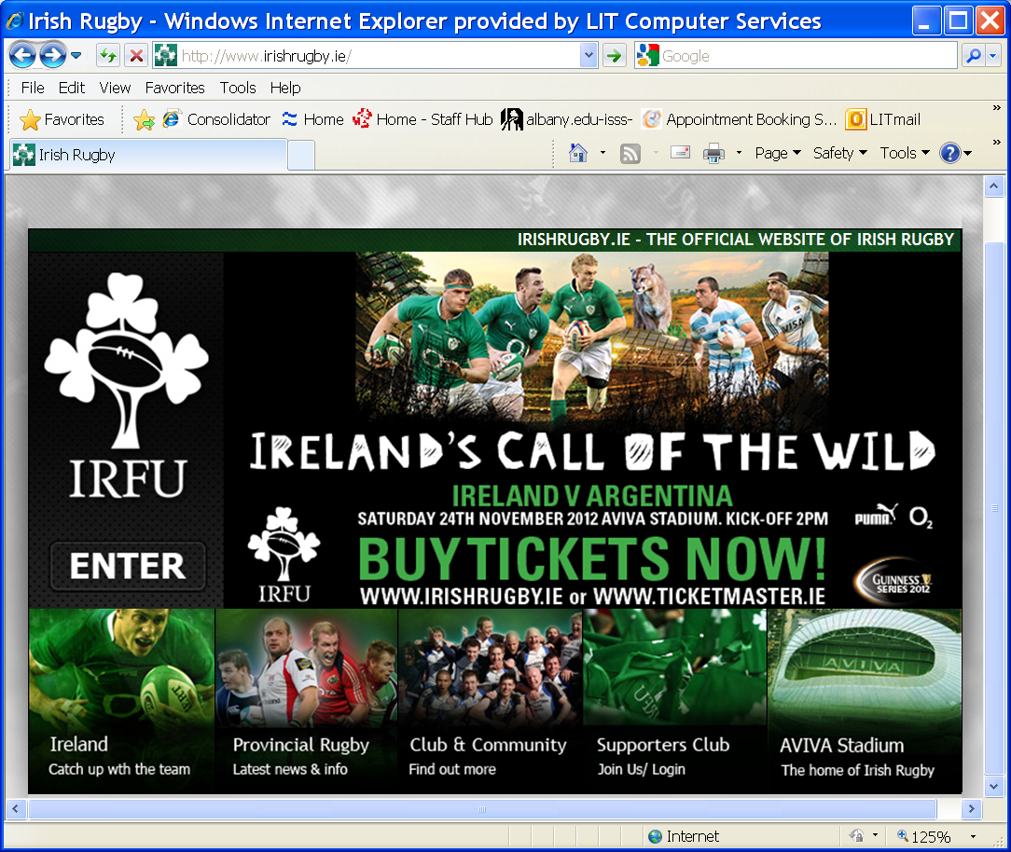
WWW and client server process
Step 6 –browser decodes html file and displays on screen
Web Server
DNS
Domain Name Server
194.154.200.217
www.irishrugby.ie
69.16.175.42
www.irishrugby.ie

Slide 18
Webserver
Is a computer program that is responsible for accepting HTTP requests from clients, which are known as web browsers, and serving them HTTP responses along with optional data contents, which usually are web pages such as HTML documents and linked objects (images, etc.).
Its job is to listen to a particular TCP/IP port for http requests (http=hyper text transport protocol)
The webserver has a special folder set up for file sharing – it contains the web pages such as ‘index.html’ and others which it serves if requested
If the webserver receives a request for a web page that’s in this folder it will transmit the file to the browser that requested it.

Slide 19
Web servers
Two most commonly used are
Apache http server – is an open source web server
IIS – Internet Information Services – is part of the Windows Operating System
Lots of others out there also .. eg ColdFusion

Slide 20

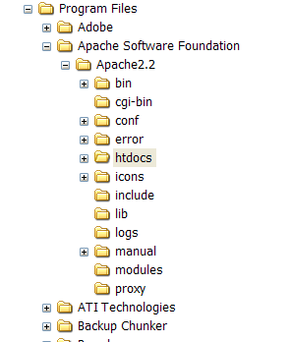
APACHE
Apache http server – is an open source web server
It can be downloaded from www.apache.org
It ‘serves’ its web pages by default from a folder called: htdocs

Slide 21
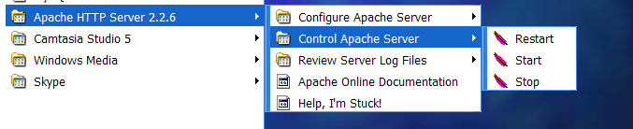
Controlling and Configuring APACHE
Once Apache is installed in a Windows machine it can be configured, started, stopped etc using the Apache program group (Start->All Programs->Apache..)

Slide 22
Test Apache
Open a browser and type in :
http://localhost:80/
Localhost is the machine you are using – so there is no need for an IP address or a DNS lookup
:80 is the TCP/IP PORT the server is listening to
Apache is usually listening to port 80

Slide 23

XAMPP
XAMPP is an easy to install Apache distribution containing MySQL, PHP and Perl.
XAMPP is easy to install, manage and configure
Get it here:
http://www.apachefriends.org/en/xampp.html

Slide 24
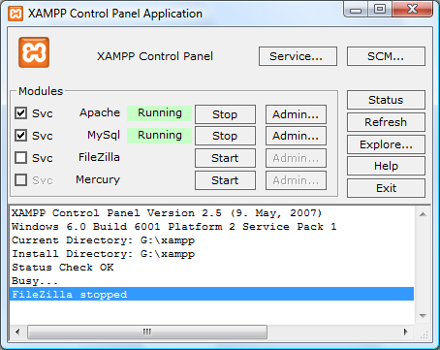
XAMPP Service Control Panel
The XAMPP service control panel can be used to start/stop/configure Apache and other services
Its usually started via an icon on the desktop after installation

Slide 25
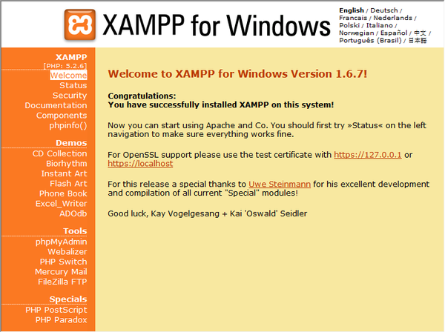
Checking XAMPP Installation
The XAMPP home page can be accessed on your browser –
http://localhost/
From here you can use tools and view some sample apps etc

Slide 26
XAMPP - WWW Root
When Apache is installed by XAMPP the web server root by default is:
C:\XAMPP\htdocs

Slide 27
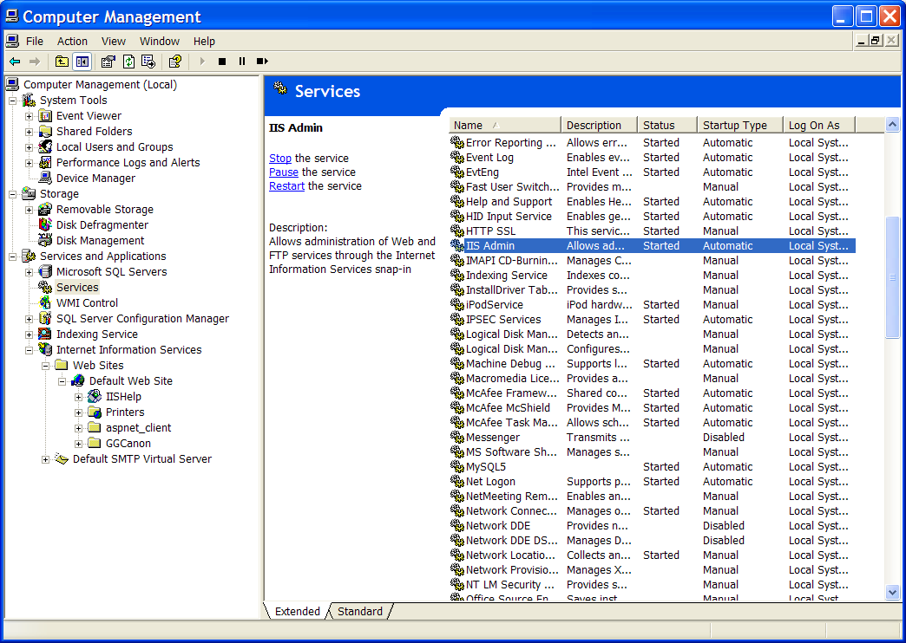
IIS
IIS is a Microsoft http server
It is stopped/started by right clicking on My Computer->Manage my computer and selecting ‘Services’
It is configured by right clicking on My Computer->Manage my computer and selecting IIS

Slide 28
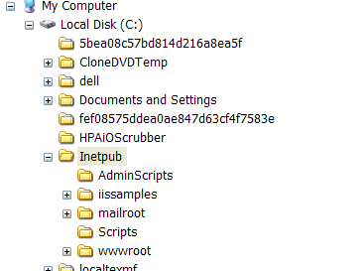
IIS
IIS normally serves the web pages from this folder: c:\inetpub\wwwroot\

Slide 29
Exercise
In your XAMPP/htdocs folder
Create a folder /dda
Create a subfolder /topic1
Create a file index.html
Use notepad to create a simple ‘hello world’ webpage by editing index.html
See notes page
Notes:
<html>
<head>
<title>Data Driven Applications II – Topic 1</title>
</head>
<body>
<h3>Welcome to DDA II homepage</h3>
<p>Welcome to the second module of this series.Here is a hyperlink to <a href="http://moodle.lit.ie"> moodle</a>
</body>
</html>

Slide 30
Other people can access your website
Anyone can access your website if they type this into a browser:
http://<your-ip>/
To find out your IP address open a command window ant type ‘ipconfig’

Slide 31
Ipconfig – find your ip address
Microsoft Windows XP [Version 5.1.2600]
(C) Copyright 1985-2001 Microsoft Corp.
C:\Documents and Settings\gerry.guinane>ipconfig
Windows IP Configuration
Ethernet adapter Wireless Network Connection:
Connection-specific DNS Suffix . :
IP Address. . . . . . . . . . . . : 192.168.2.1
Subnet Mask . . . . . . . . . . . : 255.255.255.0
Default Gateway . . . . . . . . . : 192.168.2.254
C:\Documents and Settings\gerry.guinane>

Slide 32
Know your file extensions at all times
When viewing files in any folder from now on you must at all times be able to see the vile extensions.
Control Panel>>Appearance and Settings>>Files and Folders → uncheck ‘hide file extensions for known file types’

Slide 33
Exercise: Atspace
Register for a free domain hosting service with ATSPACE (if you have not already done so)
http://www.atspace.com/
Create a FREE sub domain using your student ID number
Create a hello world page on your domain: “K0xxxxxxx.atspace.eu”

Slide 34
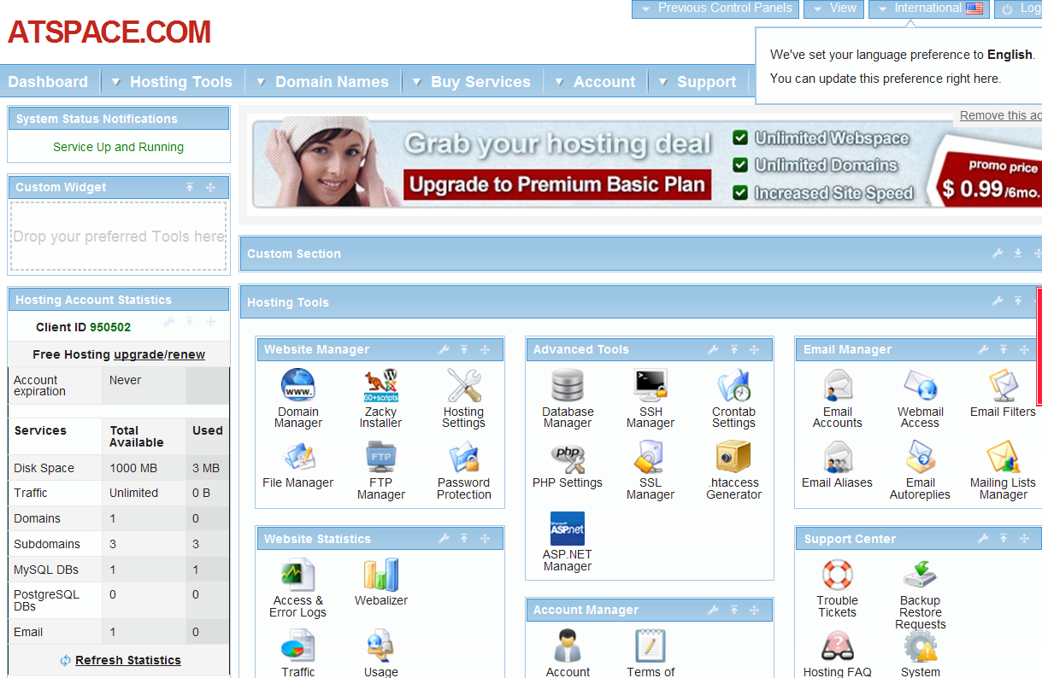
Select the domain manager in Atspace dashboard

Slide 35
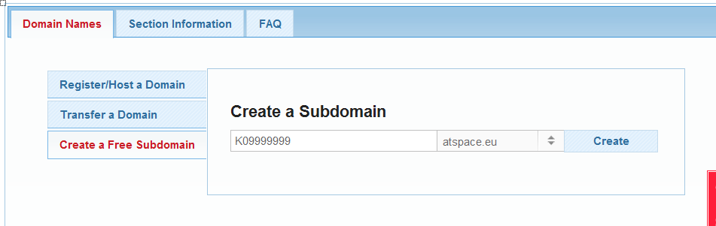
Create a free Subdomain
USE your KO number and
Choose ATSPACE.EU
Your website is now KOXXXXXX.atspace.eu

Slide 36
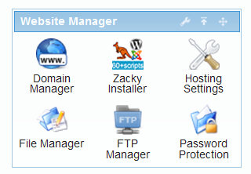
Create a home page
Use file manager on your dashboard:
When you select this option – use file manager light to manage your website files. Add a file called index.html to your website

